Slide 1
May 9, 2023
Spring 2023 COVID-19 Vaccination Updates
Bob Wines, CHP, CPM
Division of Immunization Services
WV DHHR Bureau for Public Health
Krista D. Capehart, PharmD, MS, BCACP, FAPhA
WV Board of Pharmacy
WVU School of Pharmacy
Lisa M. Costello, MD, MPH, FAAP
WV State Medical Association
WVU School of Medicine
Jeff Neccuzi, BS
Division of Immunization Services
WV DHHR Bureau for Public Health
Julia D. Fraustino, PhD
Public Interest Communication Research Laboratory (PIC Lab)
WVU College of Media

Slide 2

Roadmap
General Overview (WV HAN #212, memo) [Bob Wines]
Updates on COVID-19 Vaccines (eligibility, recs, clinical considerations) [Dr. Krista Capehart & Dr. Lisa Costello]
Other Logistics (documenting wastage, transport reminders) [Jeff Neccuzi]
Data-driven Communication (recs & resources) [Dr. Julia Fraustino]
Notes:
This is just a table of contents - not to expand on ☺

Slide 3
Overview / WV Health Advisory #212 (+ Memo)
Bob Wines

Slide 4
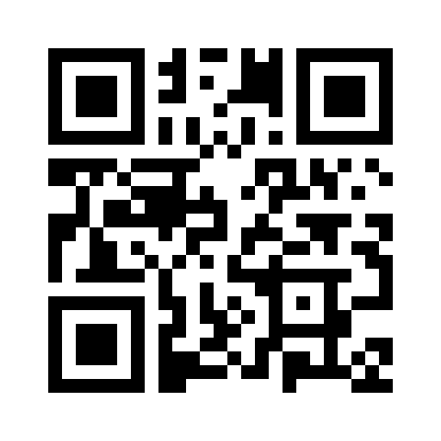
Overview
https://bit.ly/WVHAN212

Slide 5
Updates & Clinical Considerations
Dr. Krista Capehart & Dr. Lisa Costello

Slide 6

Overview of New COVID-19 Vaccine Schedule
Original (monovalent) mRNA COVID-19 vaccines are no longer authorized as boosters or primary series (document existing supply of monovalent COVID-19 vaccines as waste)
Omicron (bivalent) vaccines are now used for ALL COVID-19 mRNA doses administered
The individual’s age, vaccination history, and immunocompromise status determine what vaccine and how many doses an individual is due for to be considered up-to-date
Pfizer EUA Fact Sheet https://www.fda.gov/media/167211/download
Moderna EUA Fact Sheet https://www.fda.gov/media/167208/download
https://www.cdc.gov/vaccines/covid-19/clinical-considerations/covid-19-vaccines-us.html

Slide 7
Updated Omicron COVID-19 Shots
(authorized 8/2022 with guidelines changed 4-18-23 & 5-1-23)
Updated COVID-19 vaccines are bivalent: they are based on the original strain of SARS-CoV-2 and the Omicron BA.4 and BA.5 variants.
This vaccine helps the immune system restore protection that may have waned since previous vaccination by targeting more recent Omicron variants.
Pfizer EUA Fact Sheet https://www.fda.gov/media/167211/download
Moderna EUA Fact Sheet https://www.fda.gov/media/167208/download

Slide 8
How did we get here?
Vaccines and Related Biological Products Advisory Committee (VRBPAC) and the CDC’s Advisory Committee on Immunization Practices (ACIP) discussed use of the Omicron (bivalent) vaccine earlier this year.
In April 2023, discerned that bivalent COVID-19 vaccines are able to induce an immune response when given as either a primary series or booster dose.
  Immunogenicity data showed that a BA.1 bivalent vaccine given as a primary series induced antibody titers to BA.1 that were 25 times higher than the original monovalent vaccine
In May 2023, added guidance for 6+ months immunocompromised
ACIP Meeting April 19, 2023 Oliver available at https://www.cdc.gov/vaccines/acip/meetings/downloads/slides-2023-04-19/06-COVID-Oliver-508.pdf

Slide 9
Overview of New Recommendations
For people NOT moderately or severely immunocompromised:
  At initial vaccination, depending on the vaccine product, children ages 6 months-4 years are recommended to receive 2 or 3 bivalent mRNA vaccine doses; children age 5 years are recommended to receive 1 or 2 bivalent mRNA doses
  Individuals ages 6 years and older who are unvaccinated or only received 1 monovalent dose are recommended to receive 1 bivalent mRNA dose
  People age 65 years and older may receive 1 additional bivalent dose
  Novavax: 12 years and older who previously received 1 or 2 monovalent Novavax COVID-19 primary series are recommended to get 1 bivalent mRNA dose; in very limited circumstance could use monovalent Novavax as a 2 dose-primary series and as a booster
https://www.cdc.gov/vaccines/covid-19/clinical-considerations/covid-19-vaccines-us.html

Slide 10
Essential summary
Most individuals 6 years and older who are not moderately or severely immunocompromised and have received 1 dose of a bivalent mRNA vaccine do not need any further vaccine doses at this time.
The next section will detail specific situations for specific ages who are not immunocompromised.
Additional doses based on age and moderate-to-severe immunocompromise status will be discussed in the section on “Additional Dose(s)”
https://www.cdc.gov/vaccines/covid-19/clinical-considerations/covid-19-vaccines-us.html

Slide 11
mRNA COVID-19 Vaccines
Omicron (Bivalent)

Slide 12
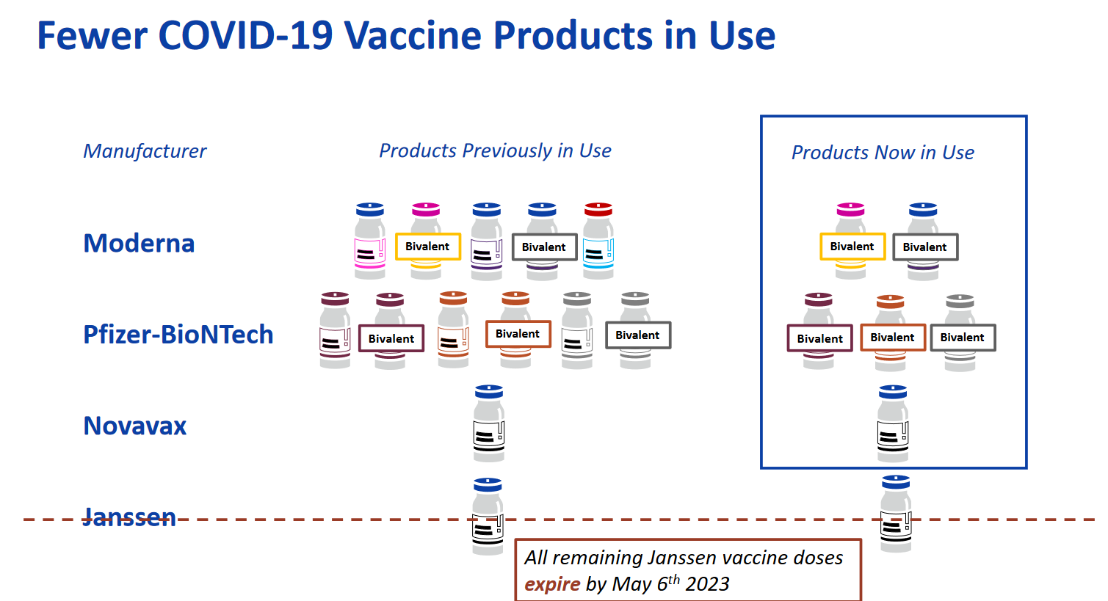
mRNA COVID-19 vaccines, bivalent
https://www.cdc.gov/vaccines/acip/meetings/downloads/slides-2023-04-19/07-COVID-Twentyman-508.pdf

Slide 13
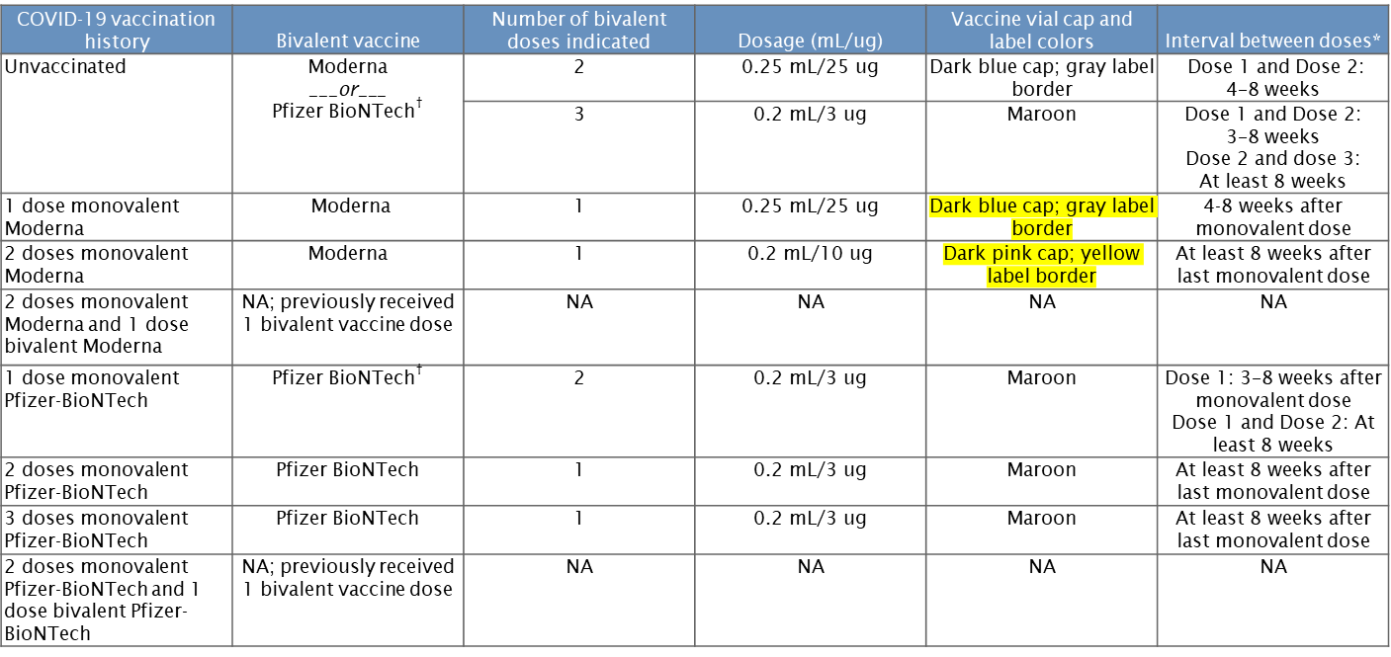
Ages 6 months to 4 years
https://www.cdc.gov/vaccines/covid-19/clinical-considerations/interim-considerations-us.html#not-immunocompromised

Slide 14
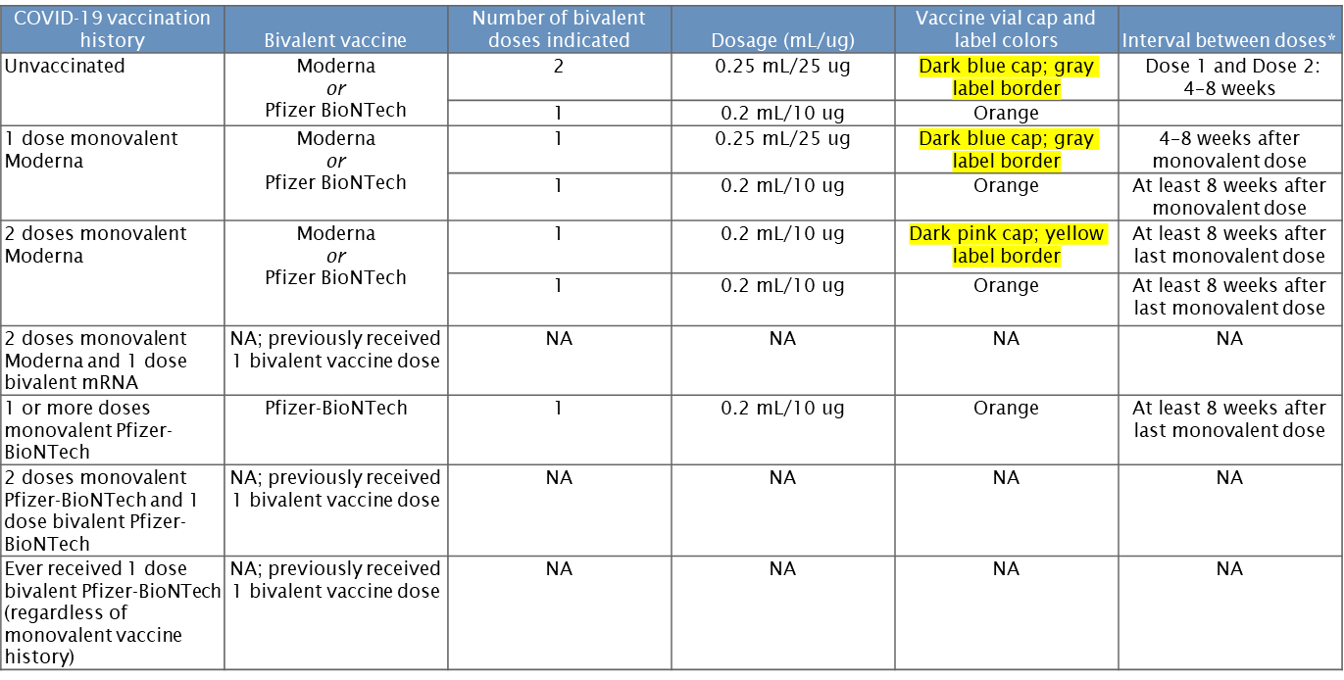
Age 5 years
https://www.cdc.gov/vaccines/covid-19/clinical-considerations/interim-considerations-us.html#not-immunocompromised

Slide 15
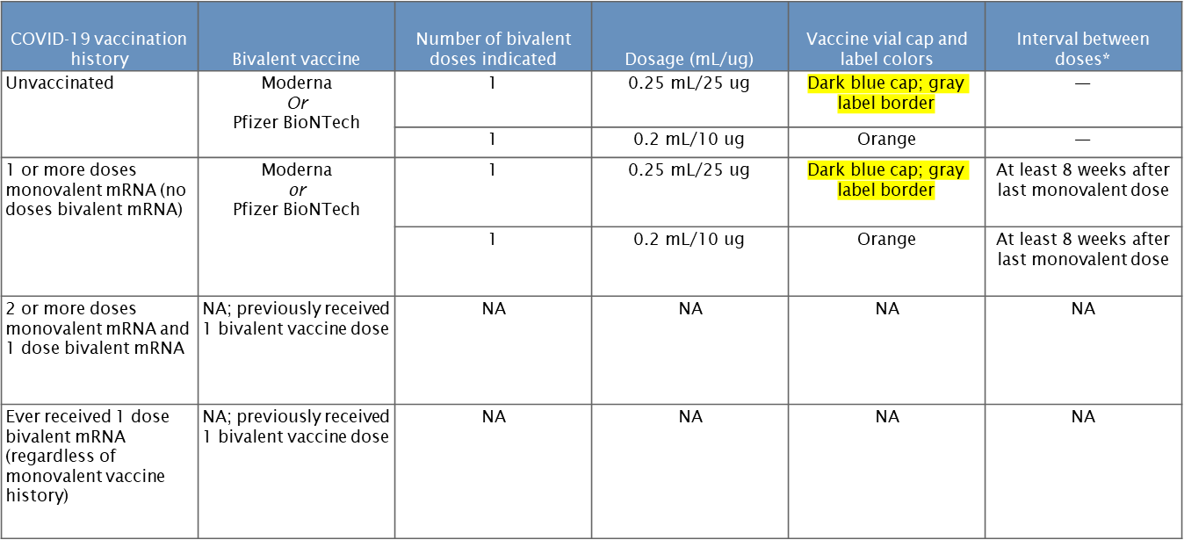
Ages 6-11 years
https://www.cdc.gov/vaccines/covid-19/clinical-considerations/interim-considerations-us.html#not-immunocompromised

Slide 16
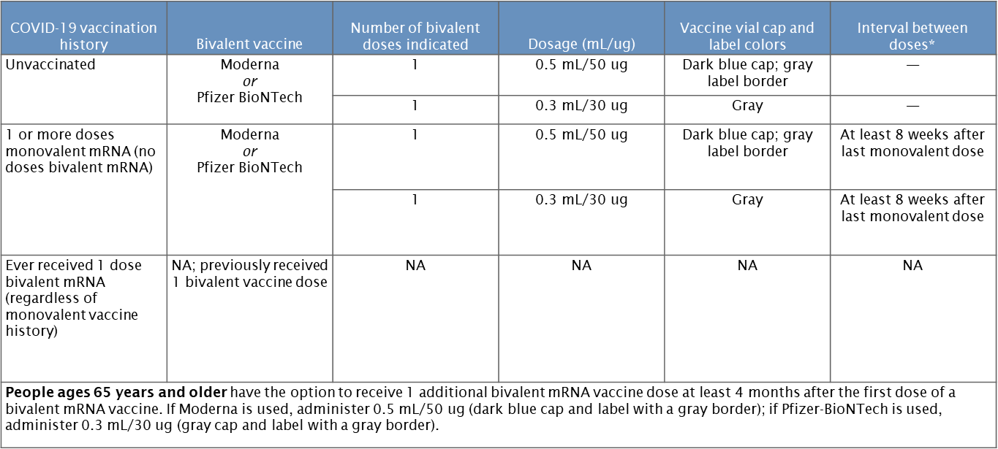
Ages 12 years and older
https://www.cdc.gov/vaccines/covid-19/clinical-considerations/interim-considerations-us.html#not-immunocompromised

Slide 17
Novavax

Slide 18
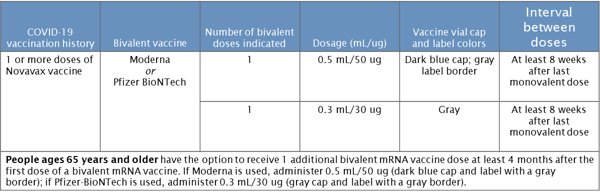
Ages 12 years and older
Novavax remains authorized for a 2 dose primary series for individuals ages 12 years and older separated by 3-8 weeks.
A booster dose in limited situations to people ages 18 years and older who previously completed primary vaccination using any FDA-approved or FDA-authorized COVID-19 vaccine; have not received any previous booster dose(s); and are unable (i.e., mRNA vaccine contraindicated or not available) or unwilling to receive an mRNA vaccine and would otherwise not receive a booster dose. The monovalent Novavax booster dose is administered at least 6 months after completion of any primary series.
https://www.cdc.gov/vaccines/covid-19/clinical-considerations/interim-considerations-us.html#not-immunocompromised
Novavax EUA Fact Sheet https://www.fda.gov/media/159897/download

Slide 19
Additional Dose(s)

Slide 20
Ages 65 years and older
People 65 years and older MAY receive 1 additional Omicron (bivalent) COVID-19 mRNA vaccine if it has been at least 4 months after their first bivalent mRNA dose.
  What should this be based upon?
    Clinical judgment of a healthcare provider
    Person’s risk of severe COVID-19 due to presence of underlying medical conditional and age
    Personal preference and circumstance
https://www.cdc.gov/vaccines/covid-19/clinical-considerations/interim-considerations-us.html#not-immunocompromised

Slide 21
Immunocompromised
People ages 6 months–4 years who are moderately or severely immunocompromised have the option to receive 1 additional dose of a homologous bivalent mRNA vaccine at least 2 months following the last recommended bivalent mRNA COVID-19 vaccine dose.
People ages 5 years and older who are moderately to severely immunocompromised and previously received an Omicron (bivalent) mRNA dose may receive an additional Omicron (bivalent) mRNA dose at least 2 months after the last bivalent dose.
Then, for all ages 6 months and older who are moderately-severely immunocompromised, healthcare providers can determine the need for additional Omicron (bivalent) mRNA doses as needed at least 2 months apart based on the level of immunocompromise for conditions such as stem cell transplant, CAR-T therapy, B-cell depletion, and others.
The immunocompromised patient determination remains a self-attestation and does not require additional documentation.
https://www.cdc.gov/vaccines/covid-19/clinical-considerations/covid-19-vaccines-us.html

Slide 22
Additional Clinical Considerations

Slide 23
Staying Up-to-Date
It is recommended that everyone ages 6 months and older stays up-to-date on COVID-19 vaccination
Everyone ages 6 years and older
  UTD when receive 1 updated Pfizer-BioNTech or Moderna COVID-19 vaccine.
Children ages 6 months - 5 years who got the Pfizer COVID-19 vaccine
  UTD if:
  Ages 6 months - 4 years and get 3 COVID-19 vaccine doses, including at least 1 updated Omicron (bivalent) COVID-19 vaccine dose.
  Age 5 years and get at least 1 updated Omicron (bivalent) COVID-19 vaccine dose.
Children ages 6 months - 5 years who got the Moderna COVID-19 vaccine
  UTD when get 2 Moderna COVID-19 vaccine doses, including at least 1 updated COVID-19 vaccine dose.
People who are unable or choose not to get an mRNA vaccine
  UTD when get the Novavax COVID-19 vaccine doses approved for the age group.

Slide 24
Anticipated side effects
Anticipated side effects (children, adolescents, and adults):
  Local: pain, swelling, erythema at the injection site
  Systemic: fever, fatigue, headache, chills, myalgia, arthralgia, lymphadenopathy
Younger children (6 months through 5 years):
  Local: pain, tenderness at the injection site
  Systemic: fatigue, irritability/crying and drowsiness/sleepiness

Slide 25
Coadministration (Multiple Vaccine Administration Simultaneously)
Routine administration of all age-appropriate doses of vaccines simultaneously is recommended as CDC best practice (for people with no specific contraindications).
  COVID-19 vaccines may be administered without regard to timing of other vaccines. This includes administration of COVID-19 vaccine and other vaccines at the same visit.
If multiple vaccines are administered at a single visit, administer each injection in a different injection site, according to recommendations by age.
Providers should offer vaccines that a patient is eligible/due for and COVID-19 vaccine at the same visit, if/as eligible.
  There are additional considerations if administering an orthopoxvirus (Mpox) vaccine (see Clinical Considerations).
https://www.cdc.gov/vaccines/hcp/acip-recs/general-recs/index.htm

Slide 26
Current/Prior SARS-CoV-2 Infection
Defer any COVID-19 vaccination at least until recovery from the acute illness and criteria to discontinue isolation have been met.
People who recently had SARS-CoV-2 infection may consider delaying COVID-19 vaccination by 3 months from symptom onset (or from positive test if infection was asymptomatic).
HOWEVER, individual factors such as risk of COVID-19 severe disease, COVID-19 community level, or characteristics of the predominant SARS-CoV-2 strain should be taken into account when determining whether to delay getting a COVID-19 vaccination after infection.

Slide 27
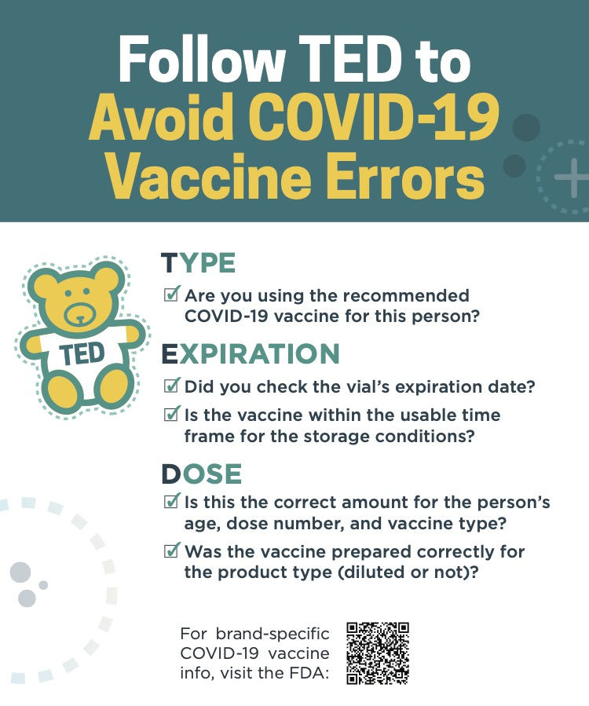
Vaccine Adverse Event Reporting System (VAERS)
For reporting adverse events or administration errors for vaccines: https://vaers.hhs.gov
1. Must report to VAERS if error adverse event occurs, and
2. Contact 1-800-222-1222, and further instructions will be provided by Dr. Elizabeth Scharman.

Slide 28
More Logistics /
Inventory Adjustments and Local, Time-Limited Transport Vaccine
Jeff Neccuzi

Slide 29
Vaccine Transport Instructions (1)
These instructions pertain strictly to local or cross-jurisdictional transport of 60 minutes maximum
Use hard-sided or Styrofoam vaccine shipping container for transport
May use original shipping boxes from manufacturers if available
Container should have cold packs on bottom and at top
There should be a layer of packing filler between the ice packs and the vaccine
Do not use “packing peanuts” as filler because they may shift and cause the ice to contact the vaccine

Slide 30
Vaccine Transport Instructions (2)
The vaccine should be in the middle of the container in between the two layers of filler
Vials must be in their original carton or placed securely in a material that eliminates or minimizes exposure to light
No matter how short the transport distance is, a digital data logger (DDL) or other thermometer should be placed in the container in case of an unforeseen delay in getting the vaccine immediately back into refrigeration
For transport estimated to take longer than 1 hour, a DDL must be used

Slide 31
Positioning of Package Contents
Position of cold packs, filler and vaccine within container
Cold Packs
Filler
Vaccine Package
Filler
Cold Packs
→
→
→
→
→

Slide 32
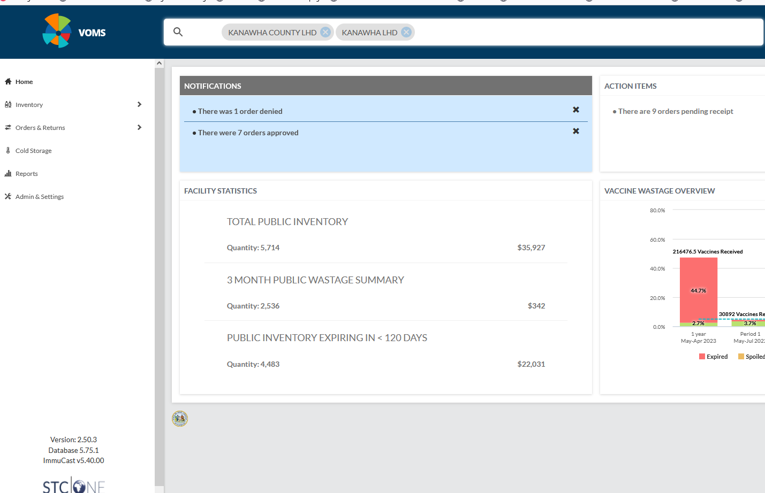
VOMS Home

Slide 33
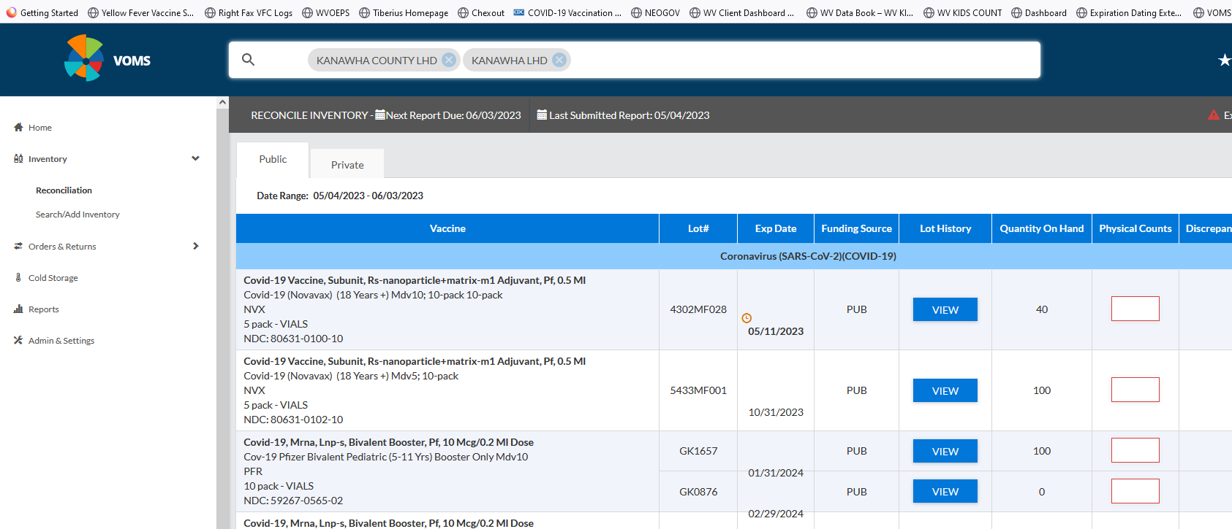
Reconciliation

Slide 34
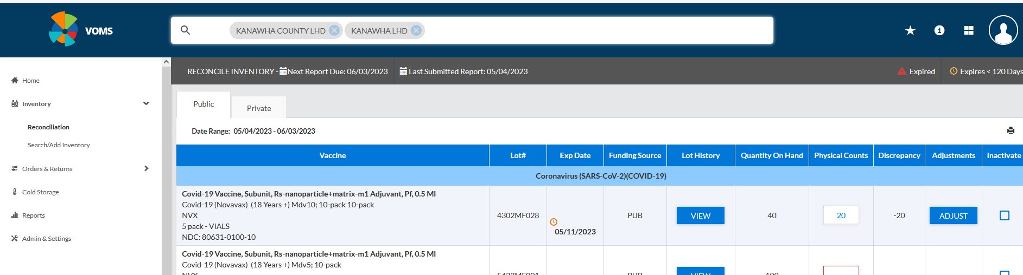
Adjust Inventory

Slide 35
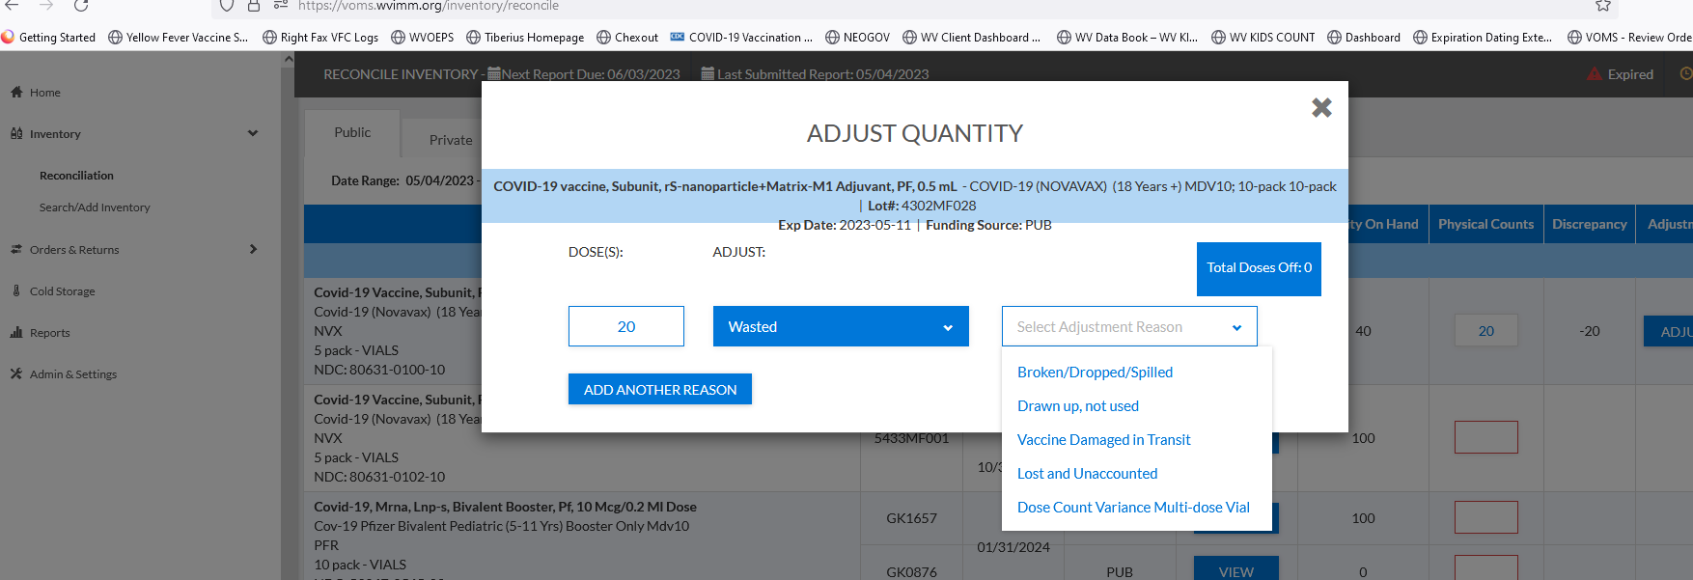
Adjustment Category

Slide 36
Data-driven Communication & Resources
Dr. Julia Fraustino

Slide 37
Boosting Vaccine Confidence
You are most trusted and your recommendation matters
  #1 trusted source of COVID-19 health information among West Virginians
  A top trusted source among your family, friends, and communities
Terminology note revisited
  As you know, word choice matters. For public:
    Bivalent vaccine = greater barriers, more confusion, more negative attitudes, statistically lower vaccination intentions
    Updated Omicron shot = reduced barriers, less confusion, wider array of attitudes (including positive), statistically higher vaccination intentions
Based on WV statewide data from WVU PIC Lab – contact jdfraustino@mail.wvu.edu

Slide 38
Predicting WV Parent/Guardian Intentions to Get Child/Teen Another COVID-19 Shot (Previously Vaccinated)
P/G Vaccination Intentions for C/T
Hell No | 2%
Need Much More | 10%
On the Fence | 27%
Willing | 44%
Hell Yes | 17%
Intention predicted by:
Perceived Safety
Perceived Booster Effectiveness
Others vaccinating their children
Perceived ability to get booster
**Provider recommendation
*Based on statewide surveys of WV parents/guardians with at least 1 child under age 18y, N = 604, data collected March 2023
WVU Public Interest Communication Research Laboratory (PIC Lab) – data under embargo prior to publication, please do not distribute/post/share

Slide 39
Reminders: When Talking to Any
Patients About COVID-19 Vaccines
Start from a place of empathy and understanding
  Listen first and fully, show what you heard, and ask to provide information
  Know that it may take many conversations
  No fear, guilt, shame appeals (no hint of judgment – including nonverbals)
Help them find their reason(s) to get vaccinated
Use evidence-driven facts and personal storytelling
  No overt persuasion, or even the perception of it
Offer your clear, kind, personalized recommendation
https://www.cdc.gov/vaccines/covid-19/hcp/engaging-patients.html
https://www.cdc.gov/coronavirus/2019-ncov/vaccines/talk-about-vaccines.html

Slide 40
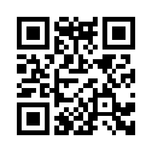
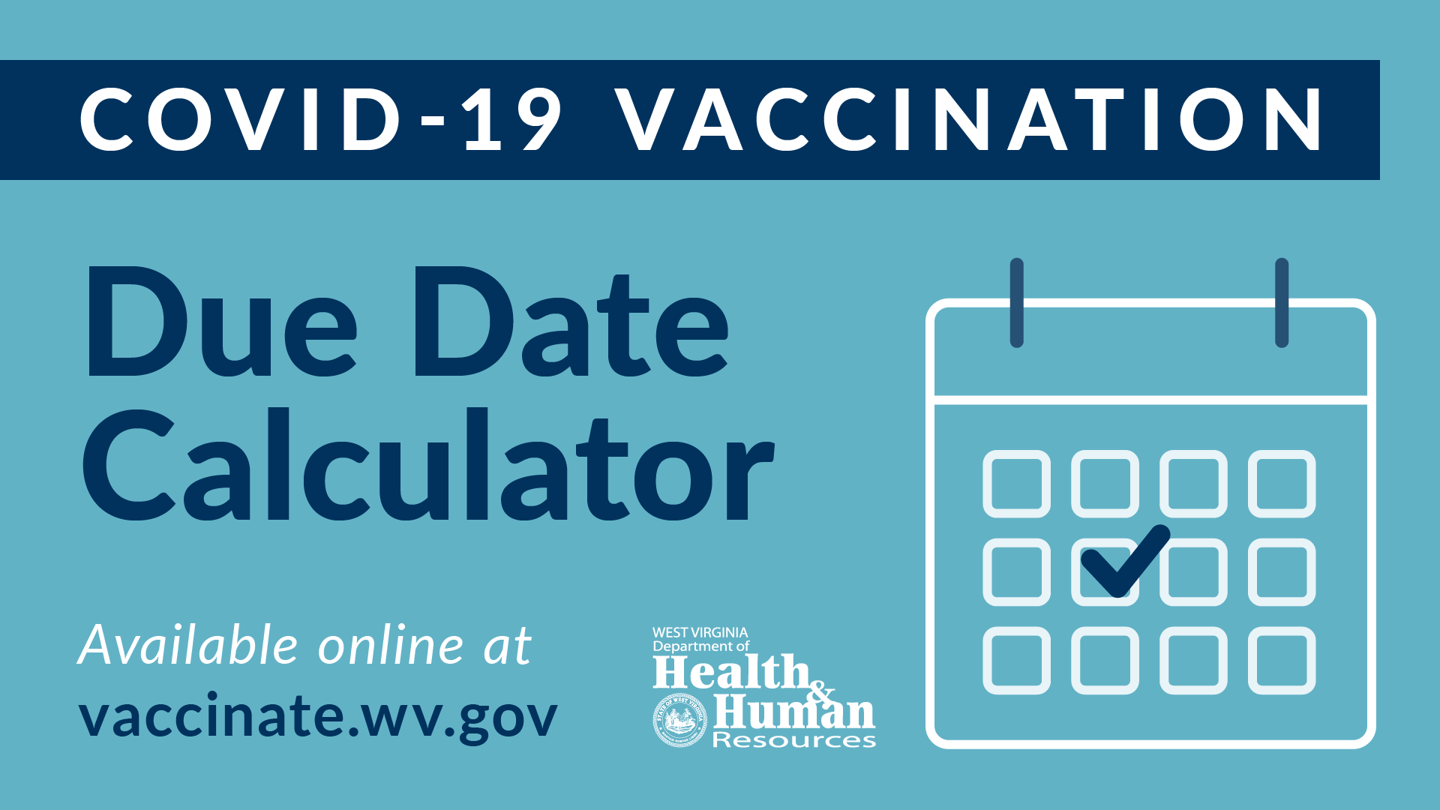
Vaccination Calculator

Slide 41
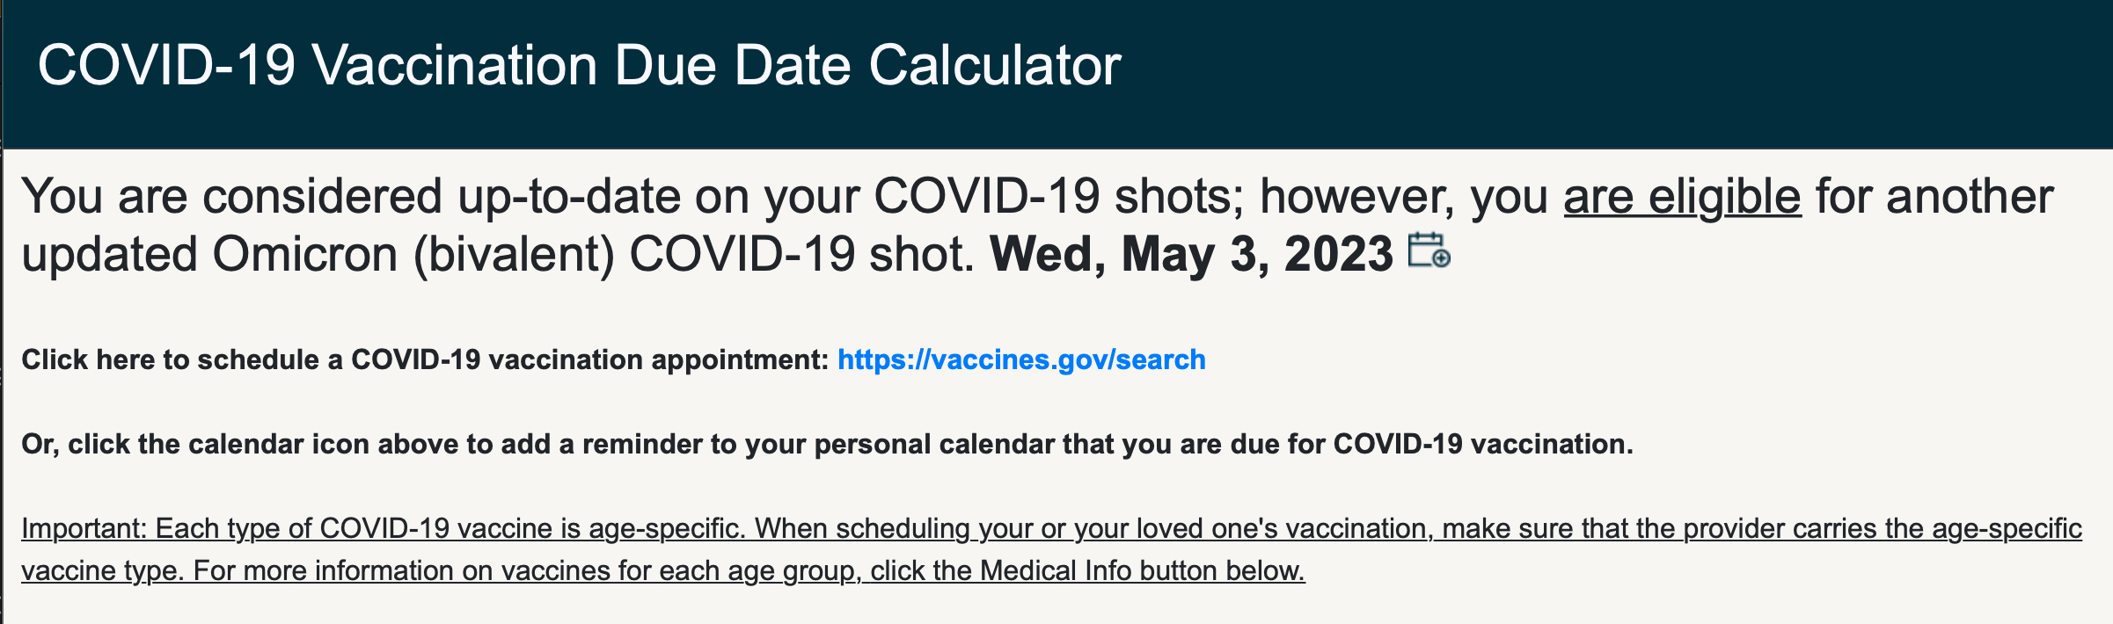
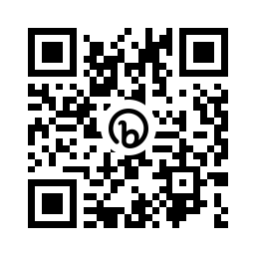
Personal Calendar Reminder
Schedule Vaccination
Find Out When You Become Due for a Shot – and
for What Type of COVID-19 Vaccine

Slide 42
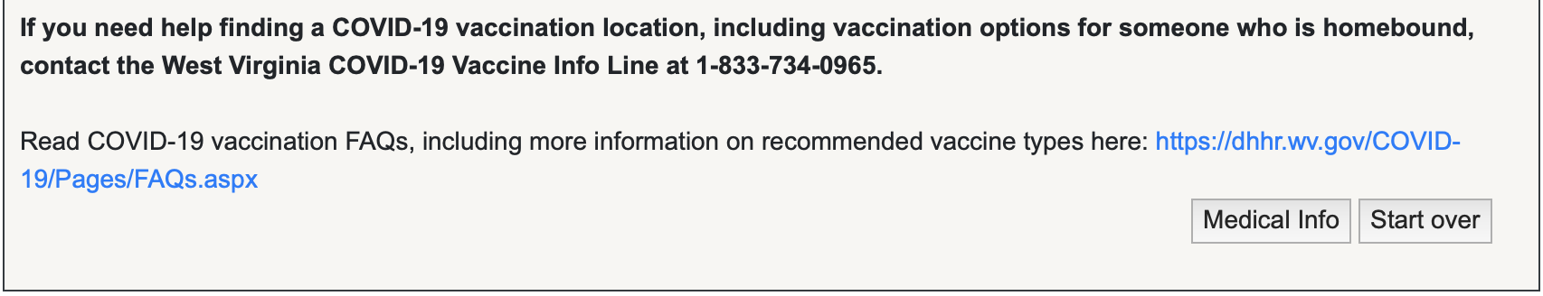
Reminder: “Medical Info” Page for Health Providers
(or anybody who wants more in-depth info)
Click this button for a page that provides a summary of entries, clinical considerations & info links

Slide 43
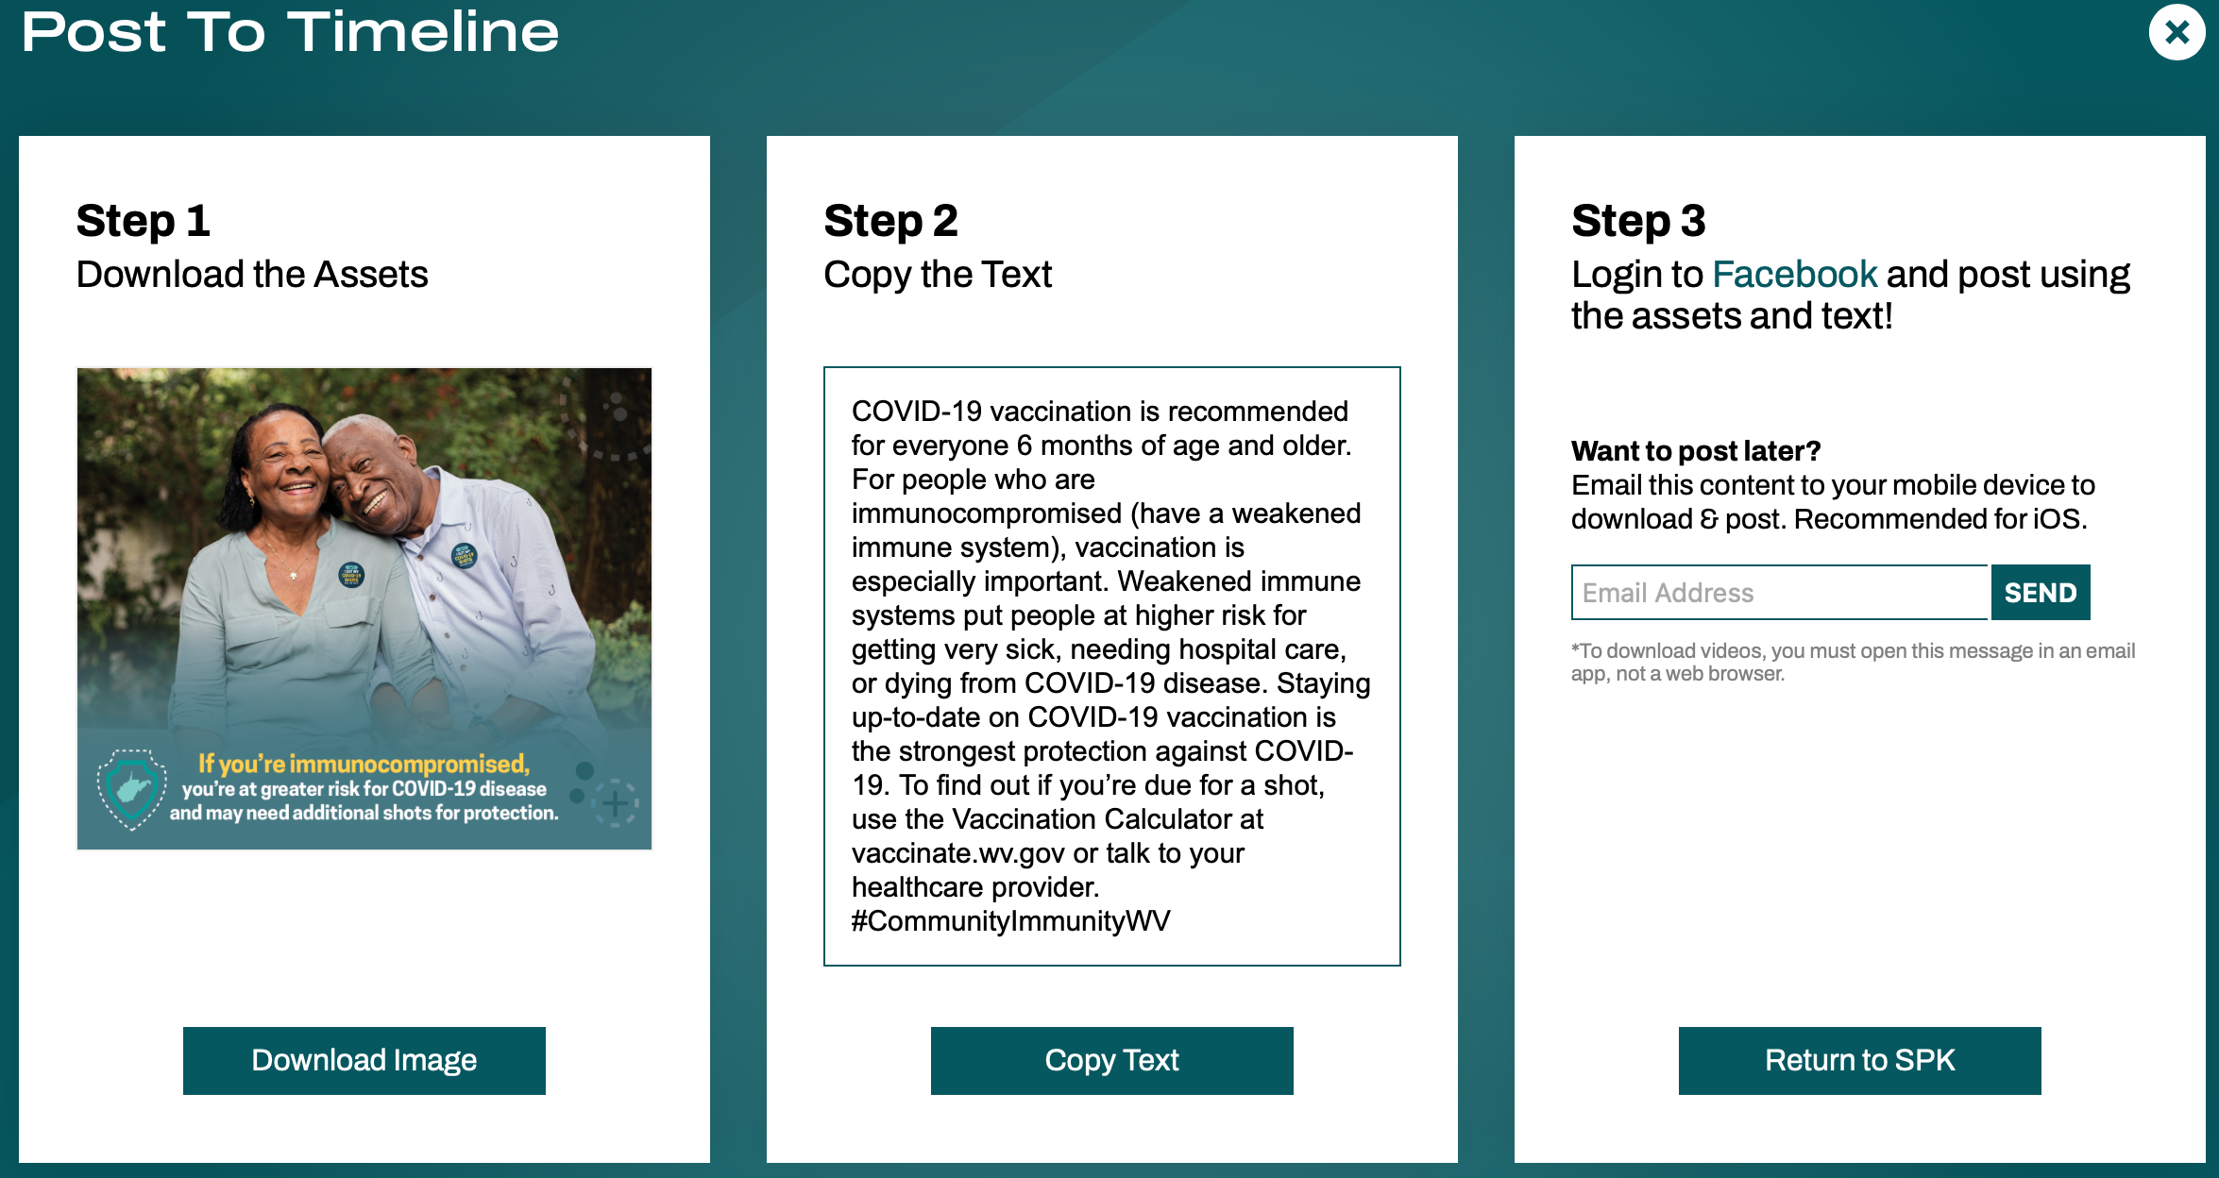
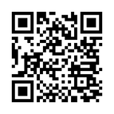
COVID-19 Vaccine Messaging Kit social media graphics, captions, printable posters, more!

Slide 44


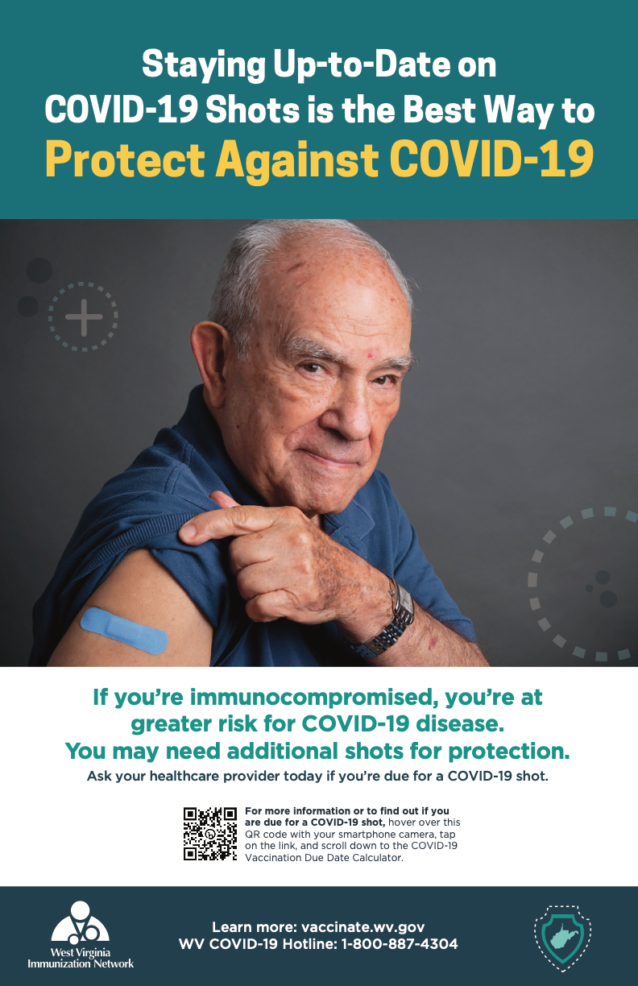


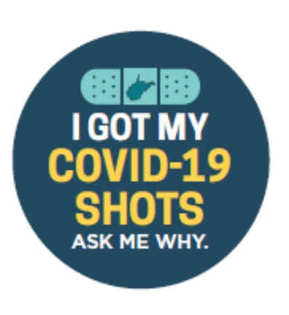
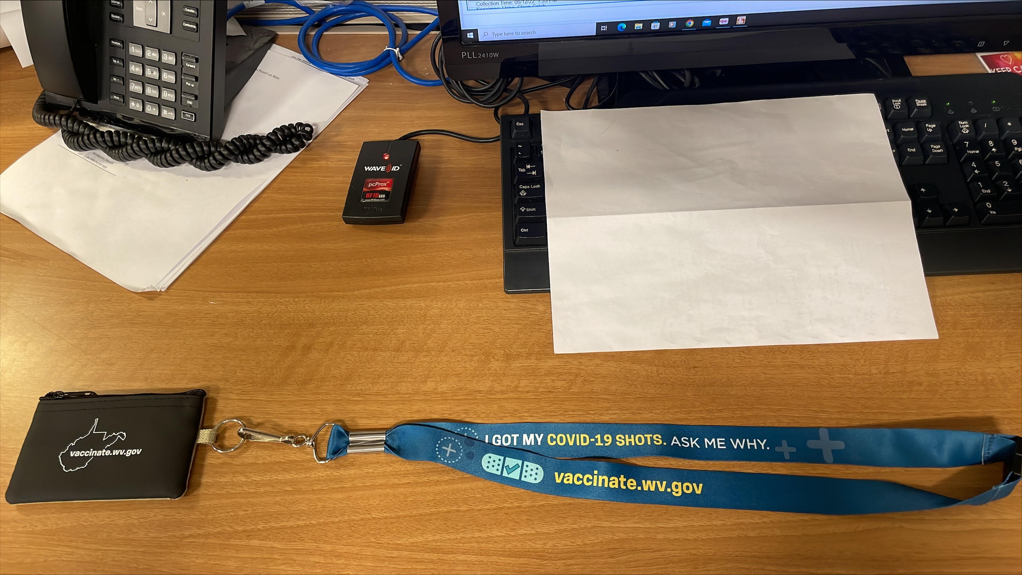
Order posters, FAQs, lanyards/holders/buttons: covidvaxwv.org/order

Slide 45
Resources

Slide 46
Questions?
Bob Wines, CHP, CPM
robert.l.wines@wv.gov
Krista Capehart, PharmD, MS, BCACP, FAPhA
Krista.d.Capehart@wv.gov
Lisa M. Costello, MD, MPH, FAAP
lmcostello@hsc.wvu.edu
Jeff Neccuzi, BS
jeffrey.j.neccuzi@wv.gov
Julia Daisy Fraustino, Ph.D.
jdfraustino@mail.wvu.edu or jic@wv.gov

